Slide 1
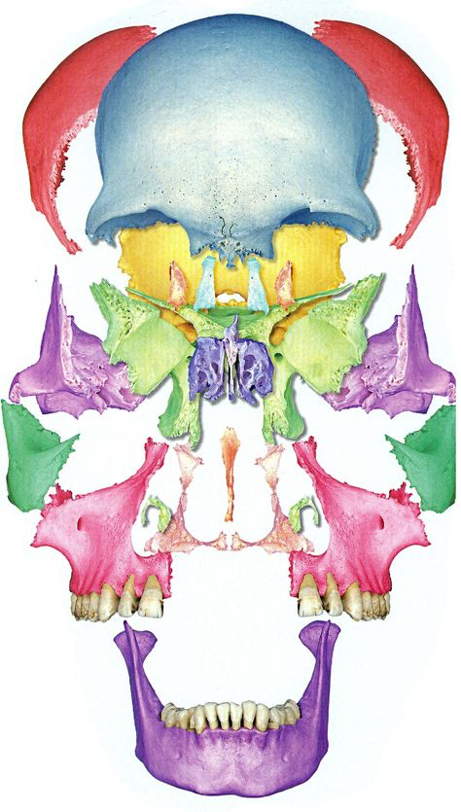
Introduction to Osteopathic Principles and Practices III
Course Coordinator: Stacia Sloane, DO

Slide 2
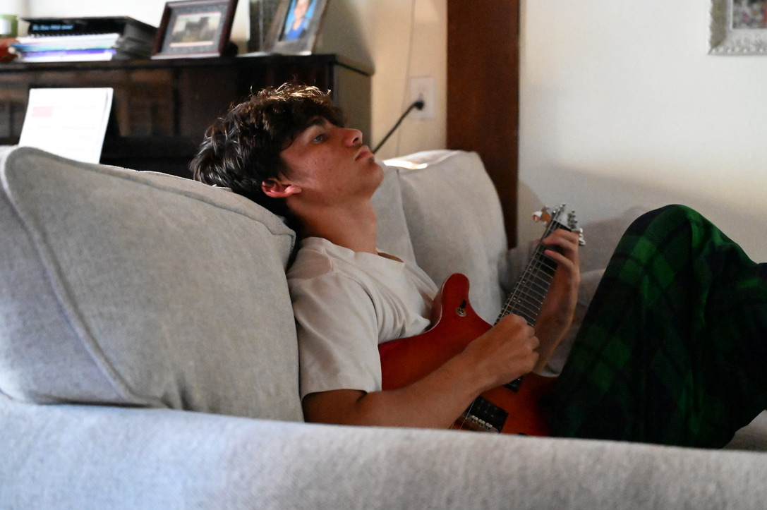
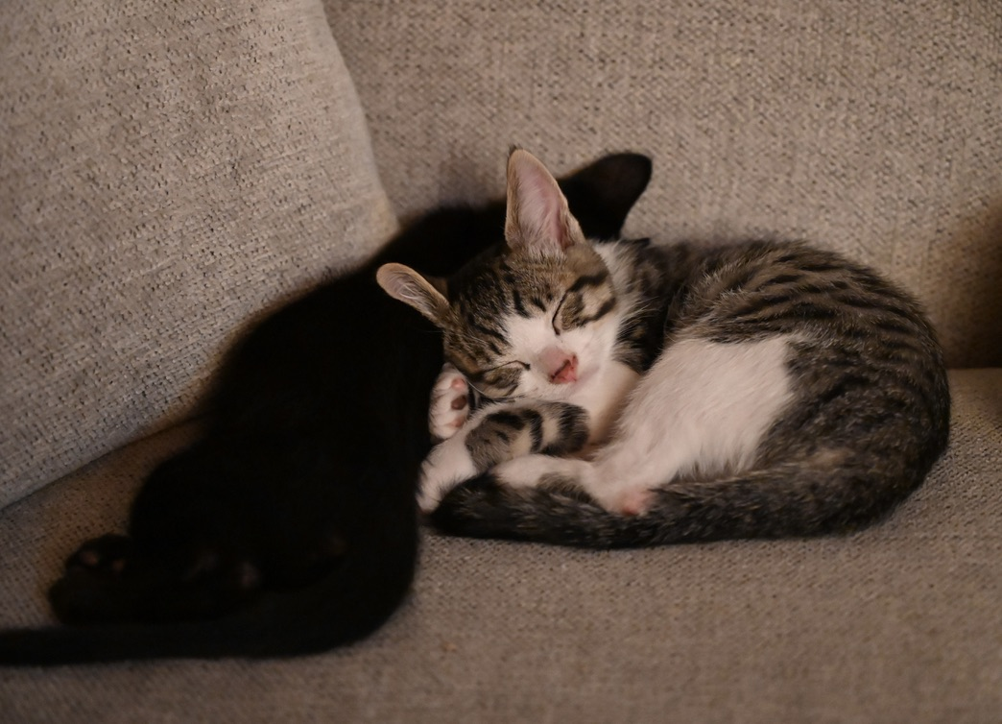
I hope you took it easy over the summer…

Slide 3
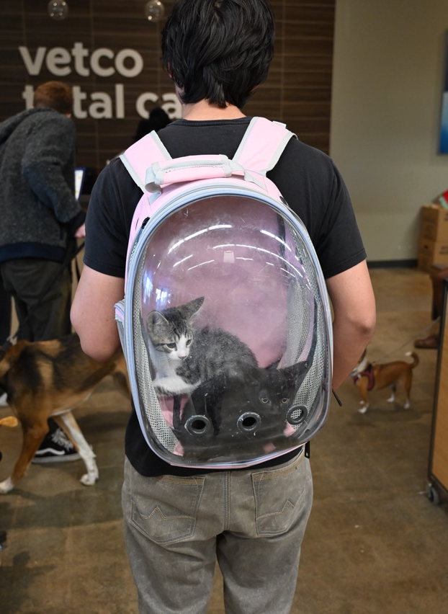


We are excited To welcome you back to School!

Slide 4
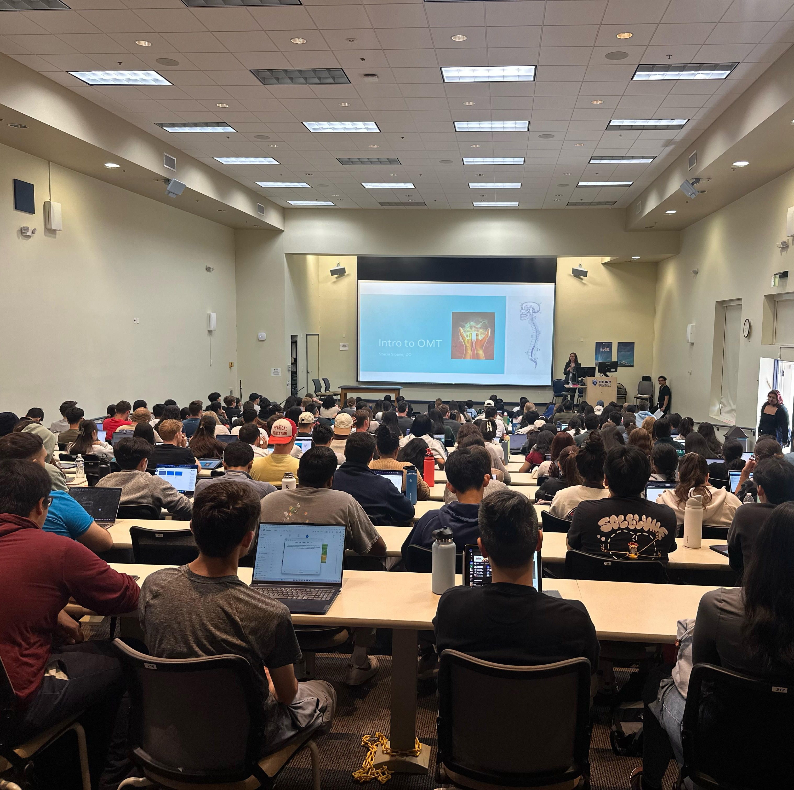
It wasn't too long ago...

Slide 5
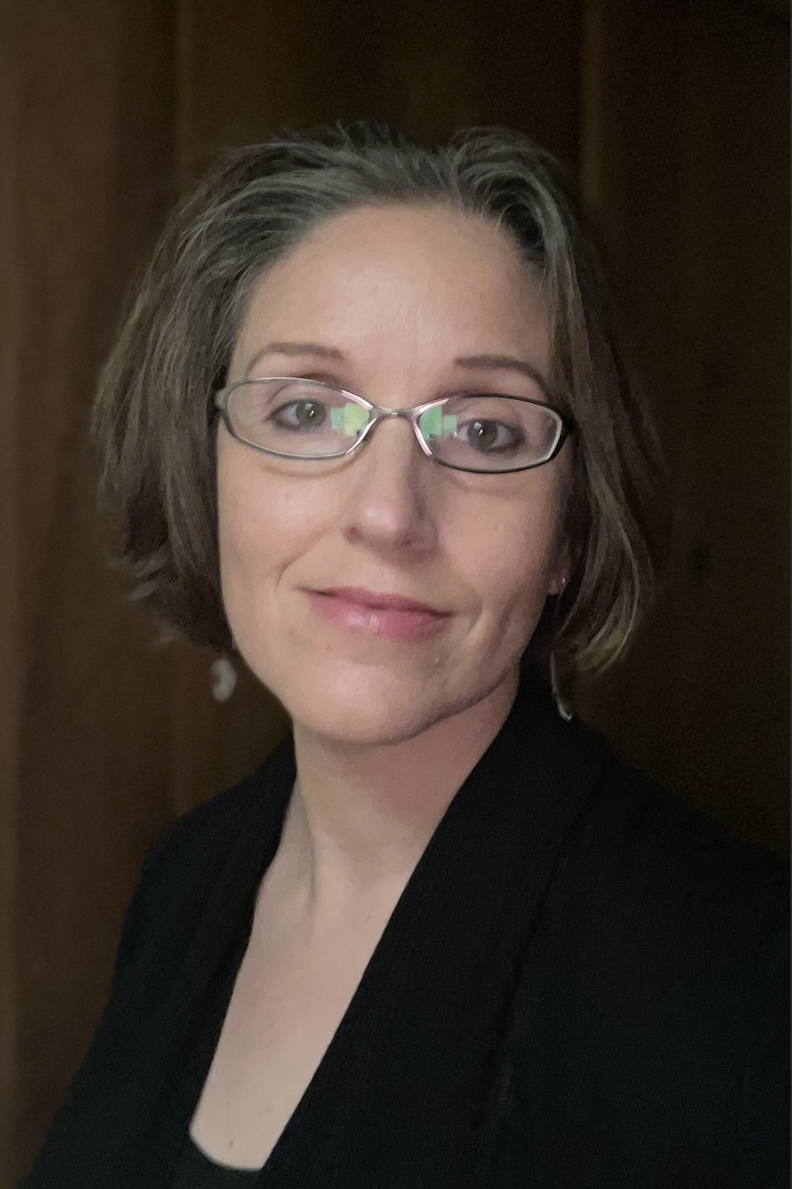
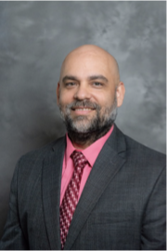
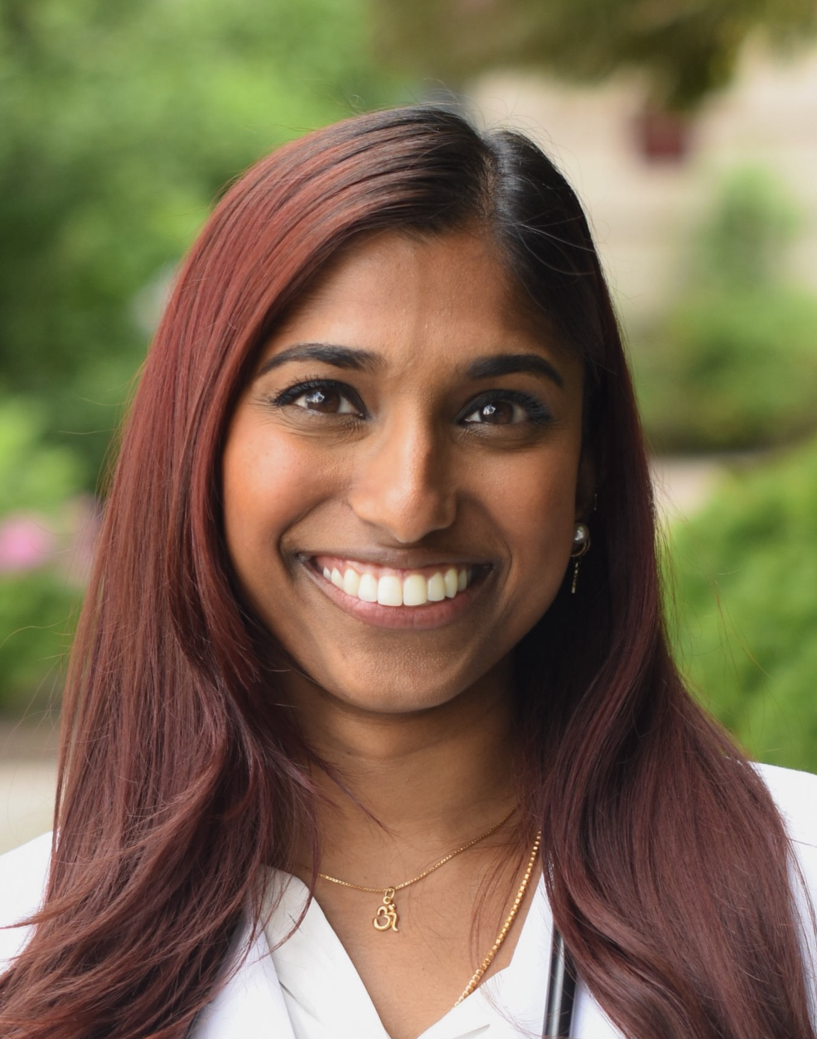
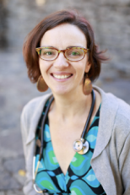
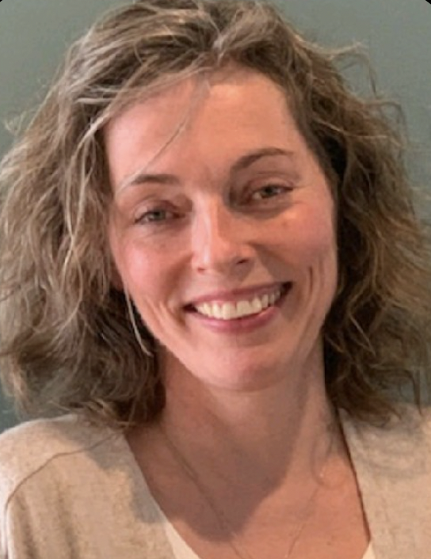
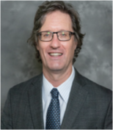
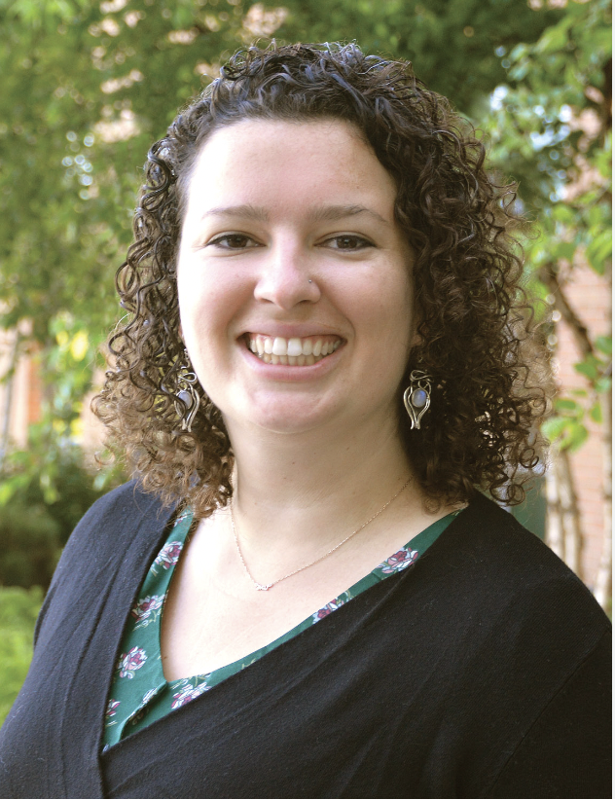
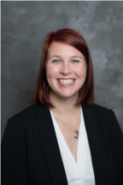
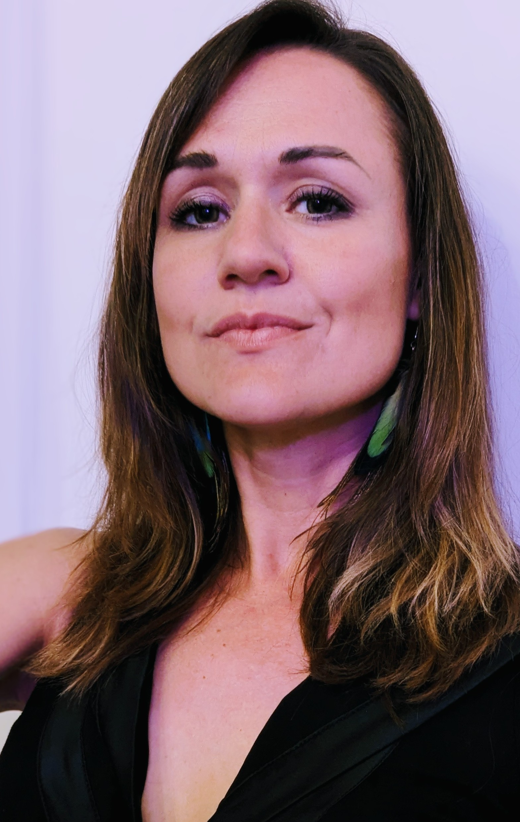
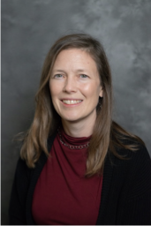
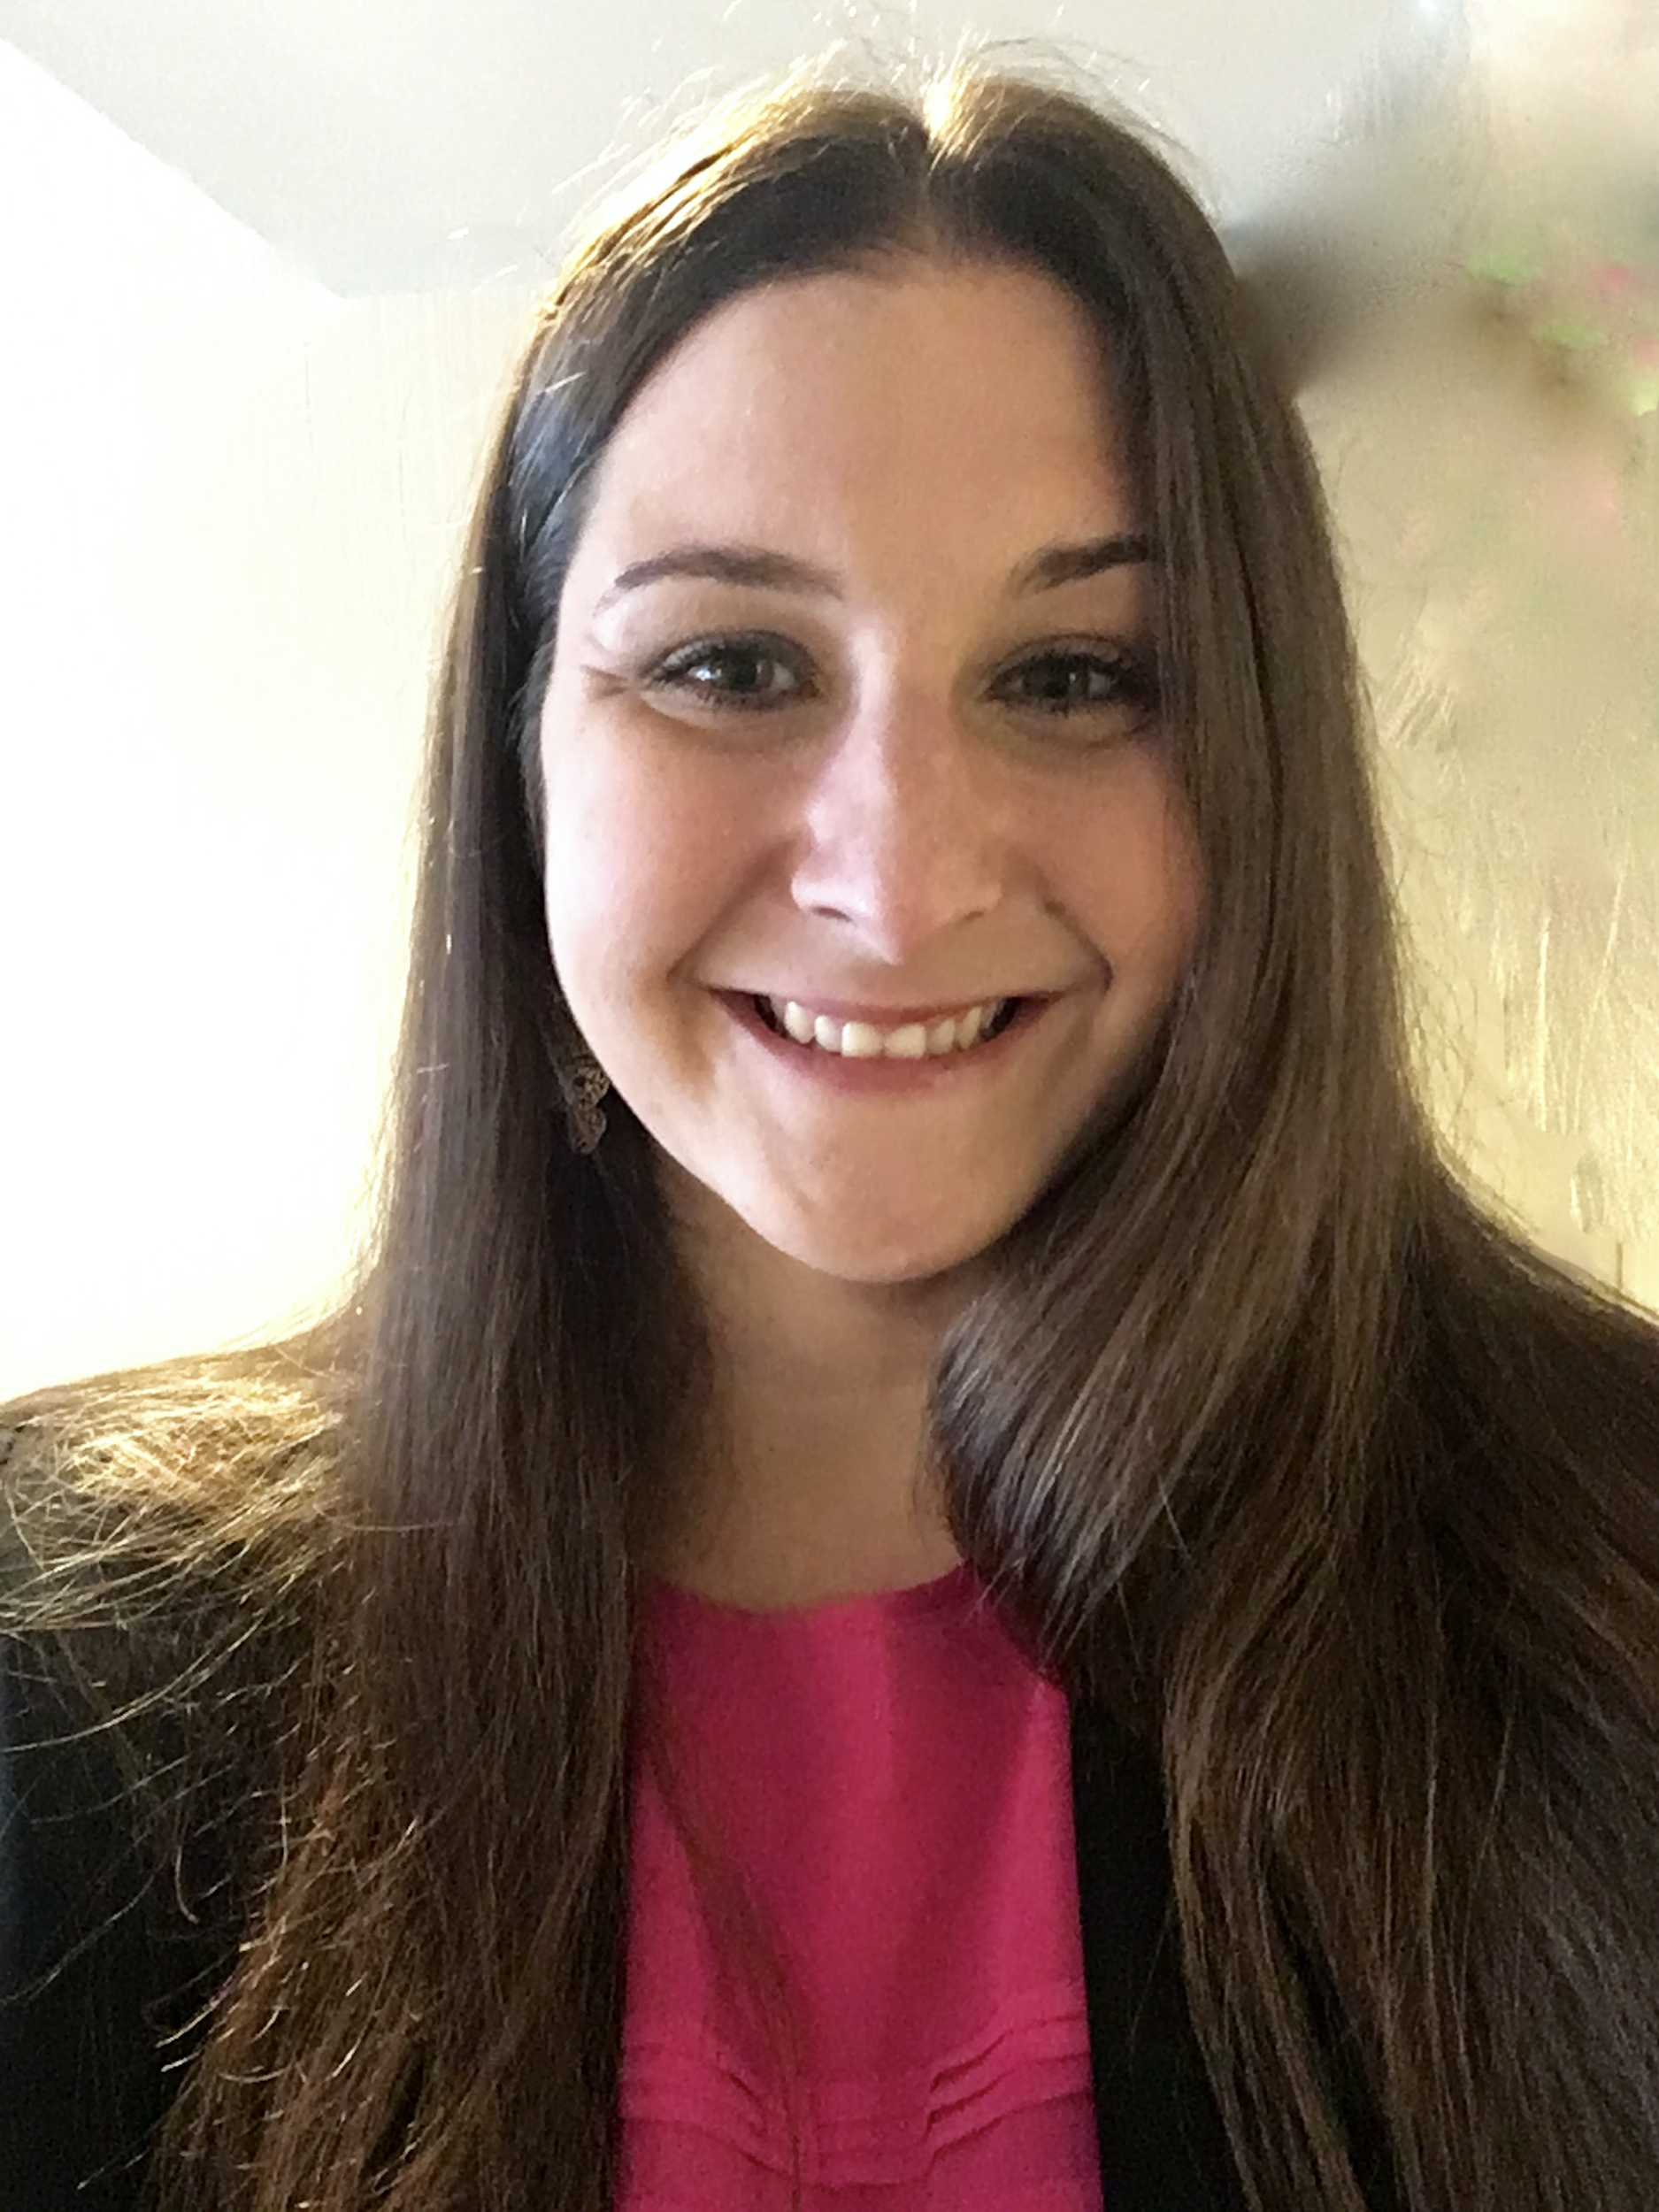
Dr. Victor Nuño
Chair of OMM Department
Dr. Stacia Sloane
OPP3 Course Coordinator
Fall 2025 OMM Faculty
Dr. Deepika Kurup
Dr. Connie Earl
Dr. Kristin Thom
Dr. Sean Moloney
Dr. Sara Modlin
Dr. Alecia Lentz
Dr. P. Williams
Dr. Lee Ann Cuny
Dr. Kimberley Wolf

Slide 6
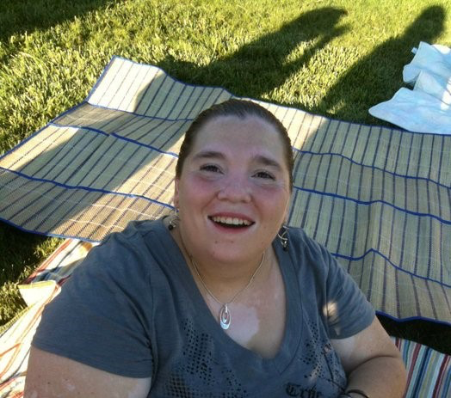

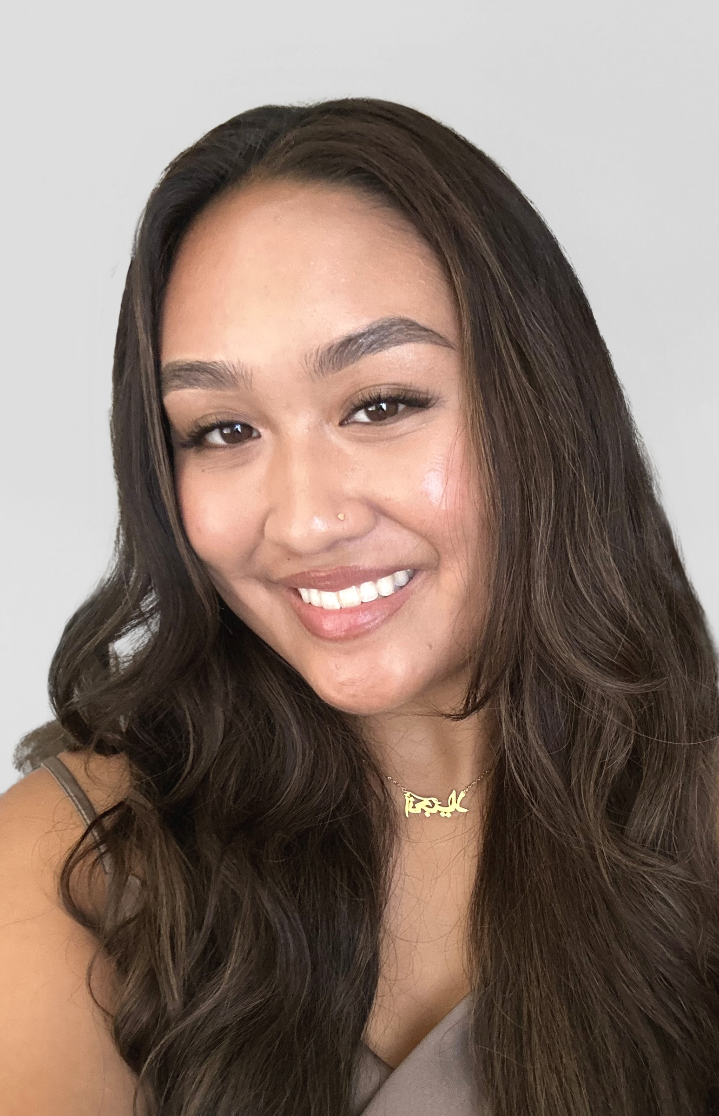
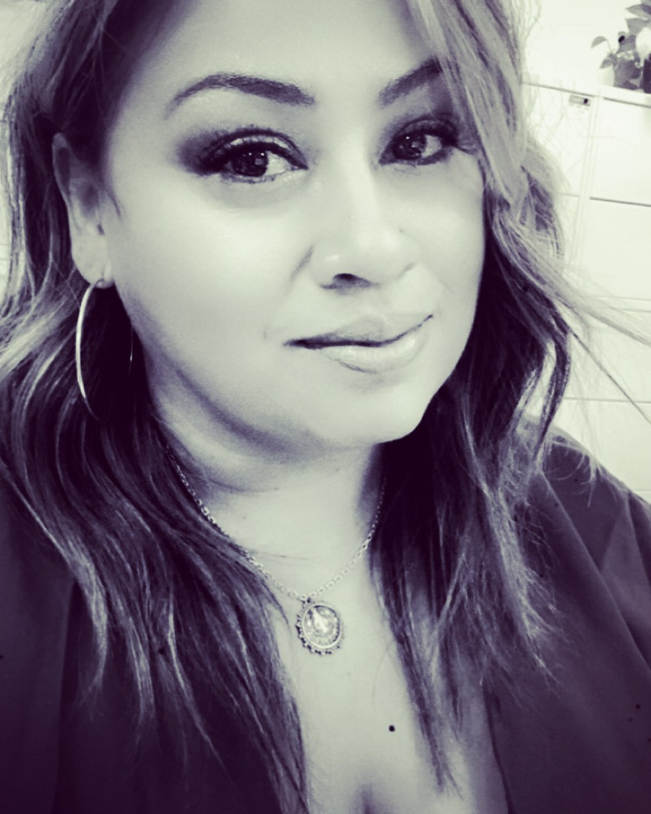
How to contact us?
Course Coordinator
Stacia Sloane, DO
Pronouns: She/Her/Hers
ssloane@touro.edu
Office hours: By appointment
Jennifer Redman (she/her)
OPP Senior Administrative Coordinator
jredman@touro.edu
Office hours by appointment
Kristina Gutierrez (she/her)
OPP Administrative Coordinator
kgutierrez@touro.edu
Office hours by appointment
Angela Abuda (she/her)
OPP Administrative Coordinator
aabuda@touro.edu
Office hours by appointment
Notes:
CANVAS--- Please make sure you have selected to receive an email alerting you to any announcements that have been posted to our OPP1 course.

Slide 7
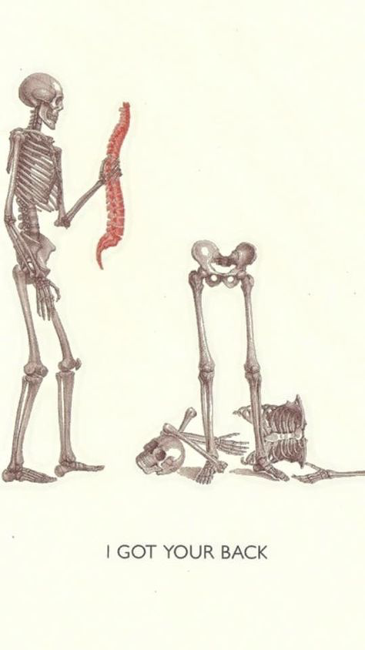
As Always…
Office Hours by appointment but encouraged with all faculty members
Keep on top of your grades and ask our administrative assistants if you have any questions about what you see
Try to keep up with the course so you don’t get stuck cramming

Slide 8
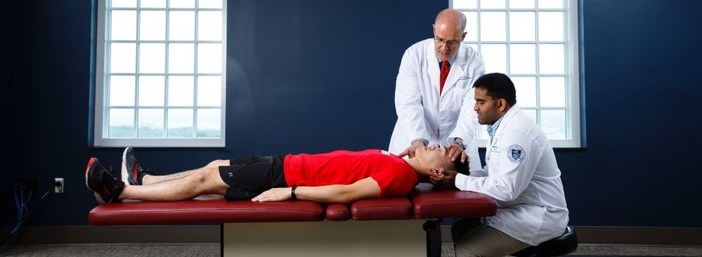
Highlights
Labs in the new space can now be recorded
Change in competencies
Theory exams now with two grades
No change in attendance policy for this semester but some clarification
More can be remediated
Syllabus has all the changes, use it…

Slide 9
We strive to make this a Safe Space
We value perspectives of individuals all backgrounds of our students including race, gender expression, gender identity, sexual orientation, country of origin, physical and learning abilities, and religious affiliations. We strive to make the OPP curriculum and the OPP Lab an inclusive safe space for all students. We reject bigotry, racism, violence, discrimination, or intimidation of any kind. If you see ways in which we can improve, please let us know.

Slide 10

The Building Blocks
OPP 1
Introduction, principles
OPP 2
Development of palpatory skills, soft tissue/ME/Mitchell Model/Counterstrain/HVLA
OPP 3
MFR, BLT, Introduction to OCMM, and treatment of extremities
Clinical correlations and applications – TMD, LBP, Crossed Syndromes, Posture/Gait/Scoliosis
OPP 4
Visceral OMT, more extremities
Case based learning- “osteopathic approach to”
3rd year
Clinical application while on rotations
Callbacks/COARs/eConferences
4th year
2-week ONMM rotation

Slide 11
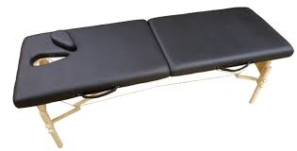
Some reminders
Can bring twin size fitted and flat sheet to lab
Draping and table protection
OMM Tables
Help keep the lab clean!
No food or drinks

Slide 12

Groups of three
A reminder that at times you may need to work in a group of three within your pod
Be professional
If treating bilaterally (e.g. extremities), one person can be patient and two treat
Rotate who is in which role
Make sure everyone gets a turn
Have one person scribe if not actively patient/doctor

Slide 13
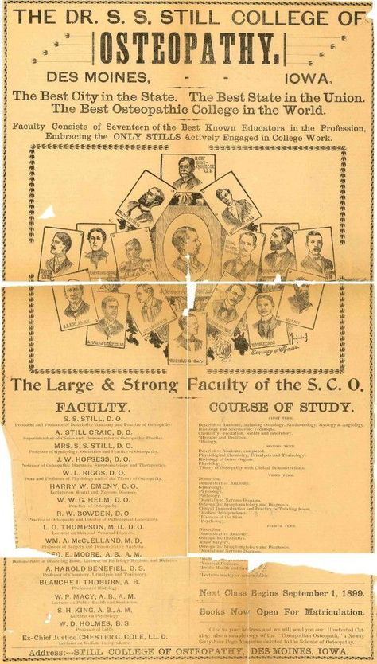
Use your resources
Books in the library
Order what you need
Go through our videos and the OMM Manual
Make use of the models in the lab
Get a TLC appointment!

Slide 14
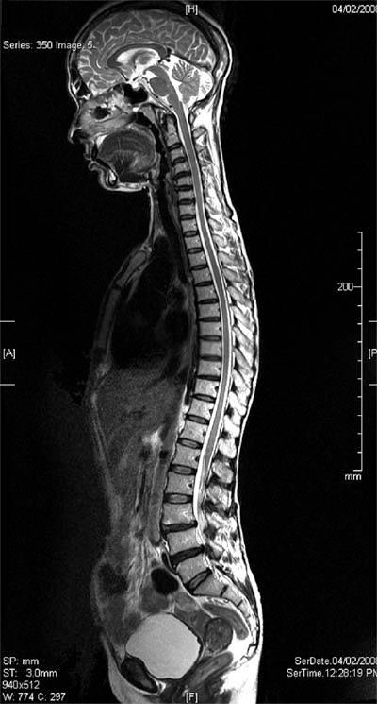
The Syllabus
Contains all the information you need
If you email me- I may tell you to reference the syllabus
Contains
Course Learning Outcomes
Book lists
OMM sessions expectations
Absences
Dress code
Switching lab times
Exemptions
Assessment and grading -for each subdiscipline
Late/Make-up examinations
Grading Grid
Syllabus Quiz Due August 11, 2025 at 8am

Slide 15
FIVE Competencies in OPP:
Subdiscipline | Material | Delivery | Assessment
Medical Knowledge (MK) | OPP theory Osteopathic principles Applied anatomy Kinesiology Biomechanics Physiology | Direct Study Lectures Reading Assignments Small Groups Assessments | Written exams Additional Course Assessments
Patient Care (PC) | Psychomotor skills used for medical diagnosis and treatment | Direct Study Lectures, OPP manual readings, discussions, and guided practice | Written exams Directed Study Quizzes
Professionalism (P) | Attendance Participation Appropriate dress Interpersonal interactions | Direct Study Lectures, Interactions with faculty | Attendance Professional interactions with faculty, staff, and colleagues
Interpersonal and Communication Skills (ICS) | Interactions with colleagues Communication with faculty and classmates | Zoom and Live lectures, virtual lab sessions | Practical Examinations
Osteopathic Principles and Practices (OPP) | Osteopathic Manipulative Techniques Application of Osteopathic theory and principles | OPP Labs | Practical Examinations

Slide 16
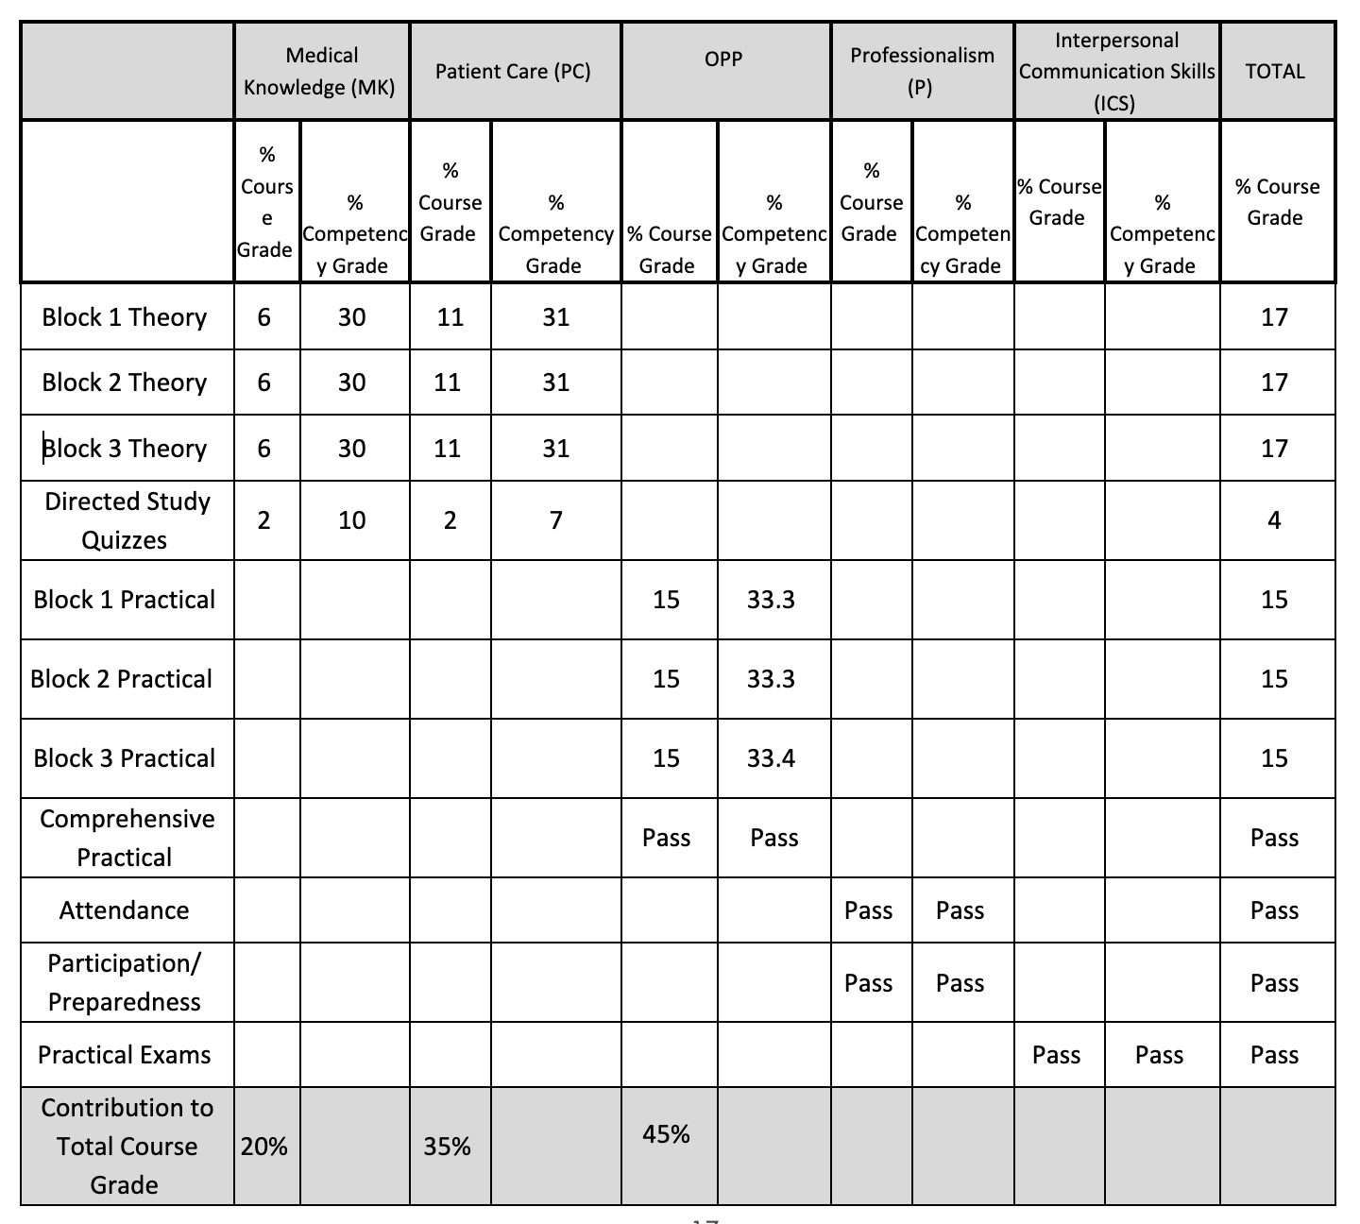
Grading Grid
Medical Knowledge skills
3 theory block exams
Quizzes
Patient Care
3 theory block exams
Quizzes
Professionalism
Attendance
Participation
Interpersonal Communication
During exams
Osteopathic Principles and Practices
4 Practical Exams
You must pass ALL subdisciplines to pass the course

Slide 17

To Pass the Course
To Achieve a Pass in the OPP3 course you must:
(all scores are without rounding)
Achieve a 70.0% or higher in your overall OPP3 Course Grade
Achieve a 70.0% or higher average on items listed on the grading grid in each of the competency categories (PC, OPP, MK, ICS, and Professionalism)
Achieve a 70.0% or higher on the Comprehensive Practical Exam
Attend 79% of the required sessions for the course. Total required events = 28.

Slide 18
What can be remediated?
Medical Knowledge – with similar cumulative exam
Interpersonal communication – with assignment
Professionalism – with assignment
Comprehensive Practical Exam – with retake of exam

Slide 19

Medical Knowledge Skills
3 Written Skill Examinations
~40% of each theory exam
Always cumulative
Focus on board content
Direct Study Quizzes
MUST PASS THIS SUBDISCIPLINE TO PASS THE COURSE
Can be REMEDIATED

Slide 20
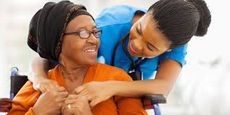
Patient Care
3 Written Skill Examinations
~60% of each theory exam
Always cumulative
Focus on board content
Direct Study Quizzes
Bonus Point will help with this!
MUST PASS THIS SUBDISCIPLINE TO PASS THE COURSE
Can NOT be REMEDIATED

Slide 21

Bonus Points
Now added to PATIENT CARE portion of exam
1 point equivalent to one point on the block exam
Due 2 weeks before the exam (to the day)
5 test style questions in multiple choice format
4 distractors all with reasons why/why not correct
Limit one set per student per block
Your questions will be sent out to students as practice questions
No late questions will be accepted (you can’t do it after the exam)

Slide 22
Patient Care vs. Medical Knowledge Stems
Medical Knowledge: Which of the following is true about a left sidebending and rotation strain pattern?
Patient Care: Which of the following groups of findings would be expected in the case of a patient with a left posteriorly rotated innominate?

Slide 23
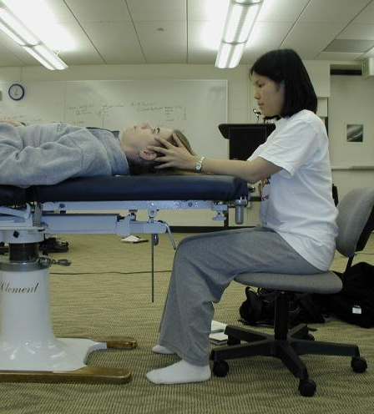
Osteopathic Principles and Practices
OPP Practical Exams
4 This semester
BLT/MFR/OCMM
OCMM/Crossed syndromes
FPR/Extremities/LBP
Comprehensive exam
MUST PASS THIS SUBDISCIPLINE TO PASS THE COURSE
Can NOT be REMEDIATED (but Comprehensive Practical CAN BE)

Slide 24
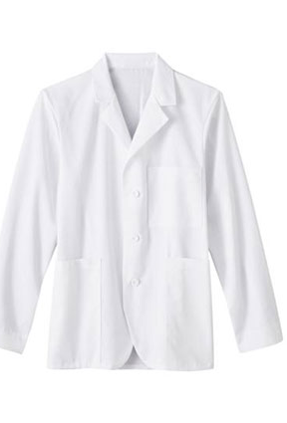
Professionalism
Required session attendance & behavior
Assessed at every required session (starred on pre-clinical calendar and listed in syllabus), labs, theory and practical exam
Attendance for all labs is expected
There will be no required make-ups this semester and all participation/professionalism points will be lost for an absense!
Wear proper attire
Have appropriate equipment
Be engaged in learning
Give and receive feedback
Interact in a professional, courteous and respectful manner

Slide 25
Tardies and attendance
MUST ATTEND >79% of REQUIRED SESSIONS TO PASS THE COURSE
Unexcused Tardy to lab
At 5 minutes lose one point, at 15 minutes lose 2 points
20 minutes late = absent
3 absences in a semester will be notified and may need to meet with CC
4 absences in a semester will meet with Academic Affairs
Professionalism concerns will always be reported

Slide 26
Exam Attendance Policy
Theory Exams
<20 minutes late, lose professionalism points only, take exam
>20 minutes late or absent with EXCUSE, take exam at later time
>20 minutes late with NO EXCUSE, take exam at later time and lose 20% of professionalism grade
Practical Exams
<15 minutes prior to exam start, lose professionalism points only, take exam
After exam start with EXCUSE, take exam at later time
After exam start with NO EXCUSE, take exam at later time and lose 20% of professionalism grade

Slide 27
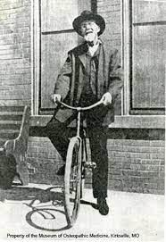
Sessions With Associated Points
Required sessions:
Introduction to OPP3
All labs
3 theory exams
4 practical exams
Must attend 79% of these events to pass professionalism (and get 70% in the competency)
Each is worth 2 points toward subdiscipline total of 56 points

Slide 28
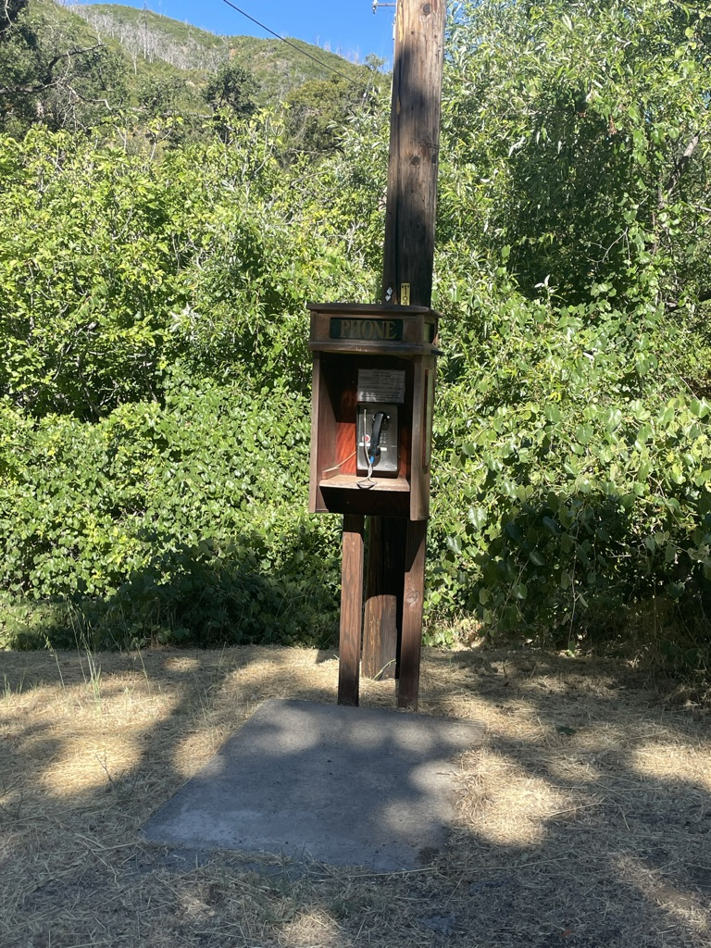
Interpersonal Communication Skills
Assessed at every PC/OPP practical exam
Have the ability to:
Speak to your attending using medical vernacular
Speak to your patient using lay terms
Ask for consent before palpation or examination
Explain what you are doing and why you are doing it

Slide 29
OPP3 Content

Slide 30
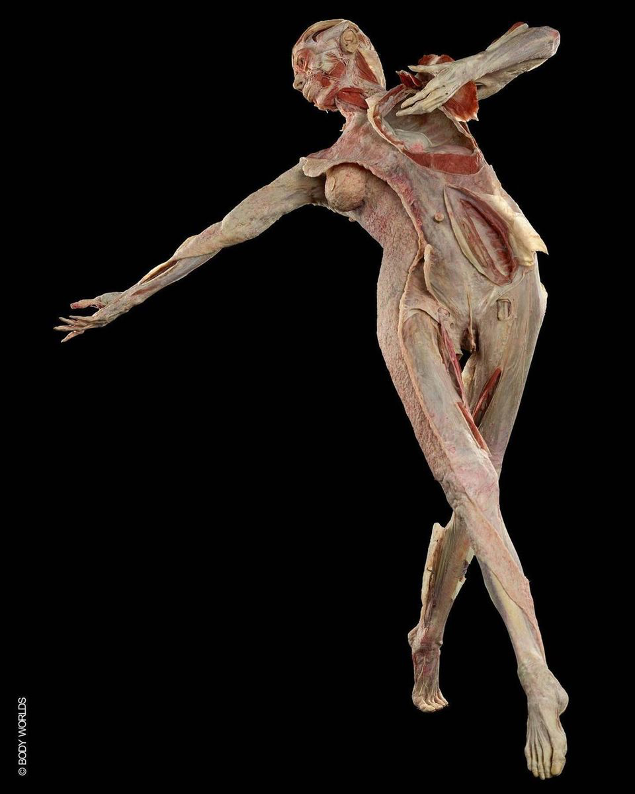
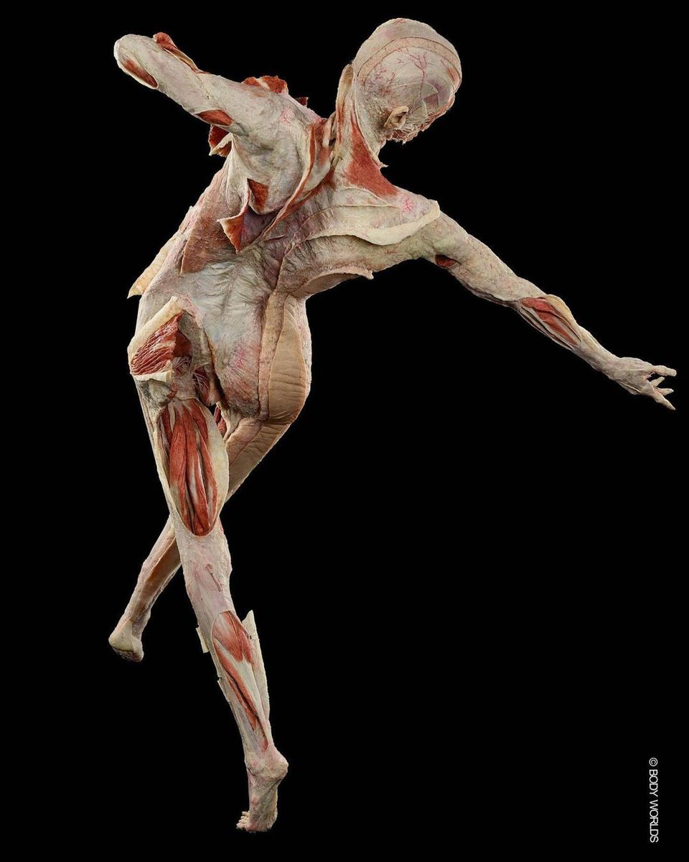
Block 1
MFR, BLT, OCMM
Directed Study (DS):
Intro to MFR and BLT Direct Study
Mind/Body/Spirit
Tensegrity and Posture
OCMM 1
OCMM 2
OCMM 3
Labs
Diagnosis and Tx Lab
Intro to MFR Lab
MFR Continued Lab
Intro to BLT and Spine BLT
BLT Ribs and Pelvis
Intro to OCMM
Practical Review Lab
2 Q&A Sessions

Slide 31
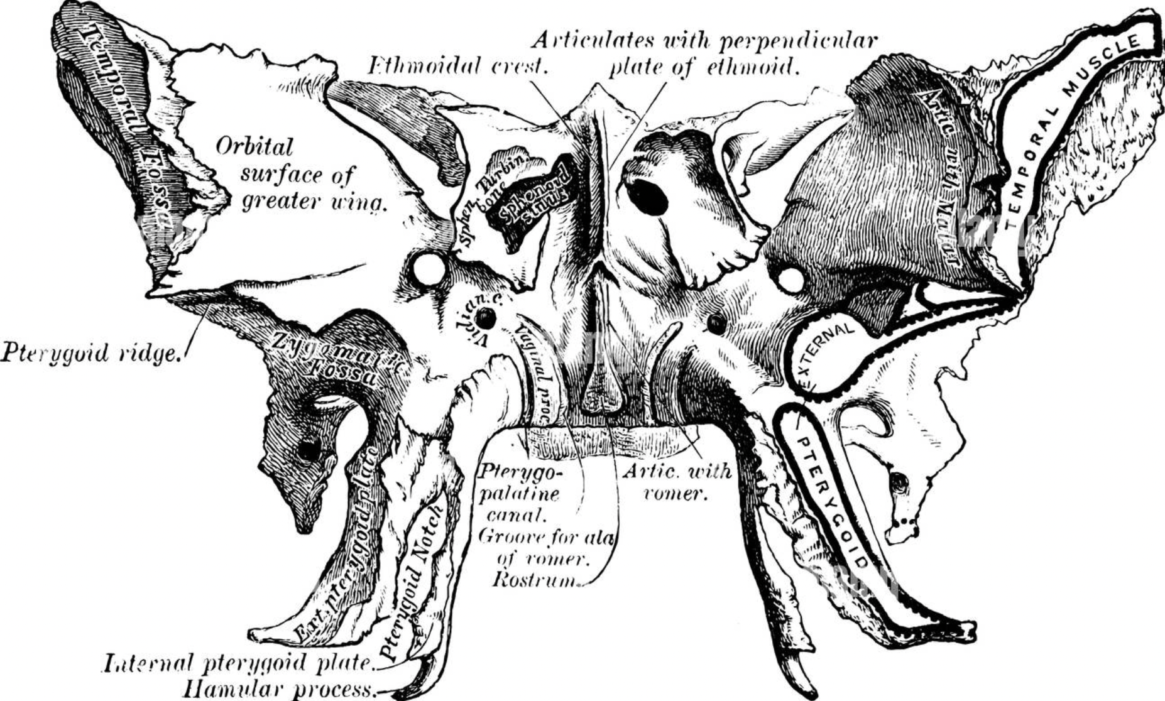
Block 2
OCMM/Crossed syndromes
Lecture/DS:
OCMM 4
OCMM 5
OCMM 6
Headache COAR Direct Study
Intro to Trigger Points
Tensegrity and Posture Direct Study
Crossed Syndromes Direct Study
Labs:
OCMM Vault
SBS/SI/LS/CV4
Temporal Bone
Osteopathic Approach to TMJD Lab
Lower Crossed Lab
Upper Crossed Lab
1 Q&A Session

Slide 32
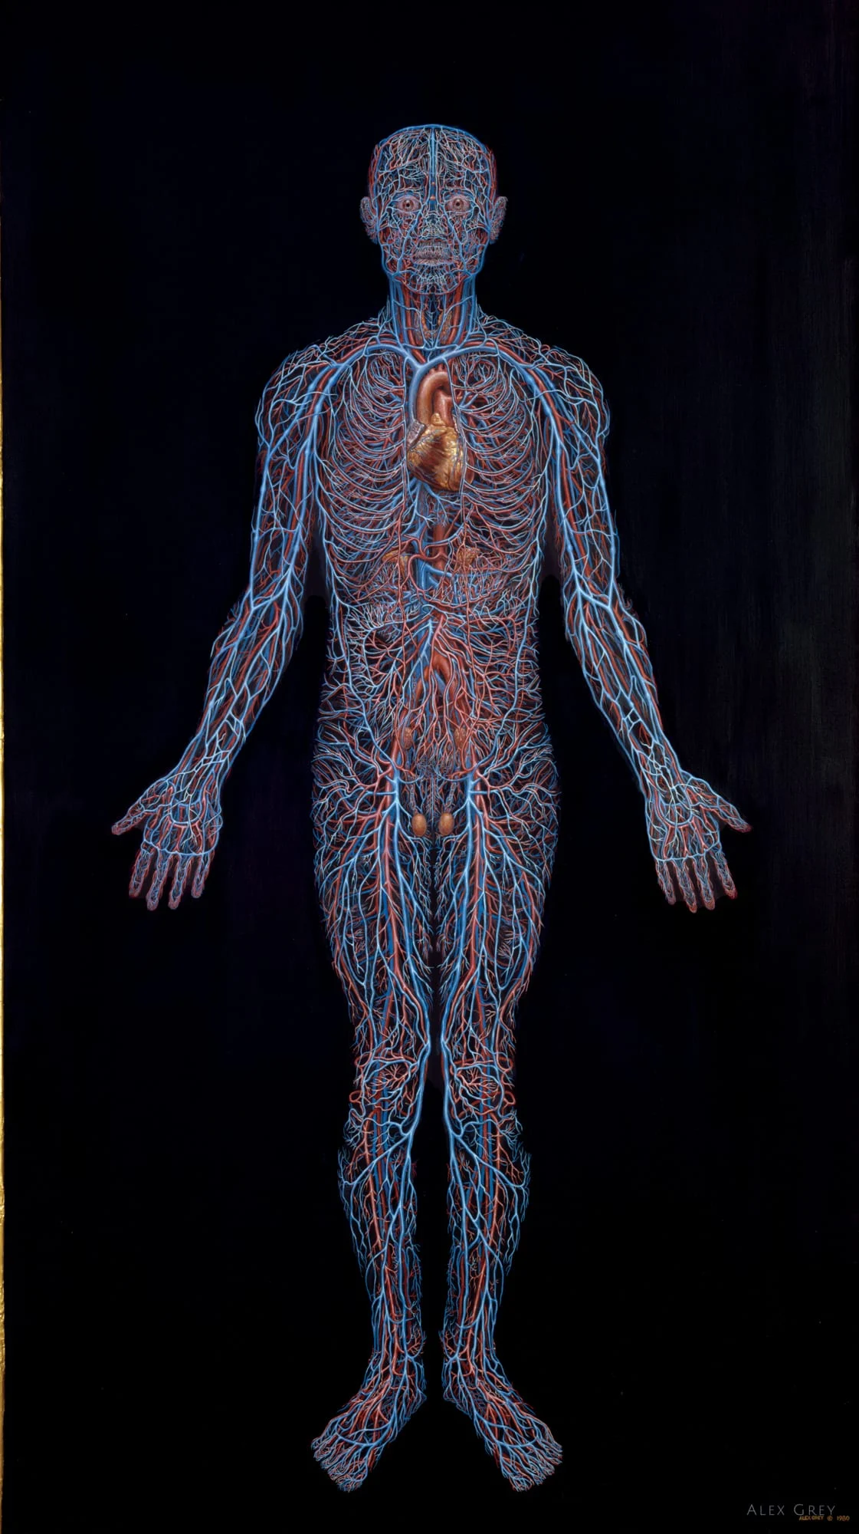
Block 3
FPR/Extremities/LBP
Lecture/DS:
Intro to FPR DS
UE COAR DS
High Yield Topics for Osteopathic Boards
LE COAR DS
LBP COAR DS
Labs:
FPR Lab
UE COAR Lab
LE COAR Lab
LBP COAR Lab
Posture, Gait, and Scoliosis Lab
Practical Review Lab
Comprehensive Practical Review Lab (may have opportunity to do Practical)
1 Q&A Session

Slide 33

Feedback
Formative
Quizzes
Live Q&A
Talk with faculty
After practical and didactic exams
Summative
Practical Exams
Theory Exams

Slide 34
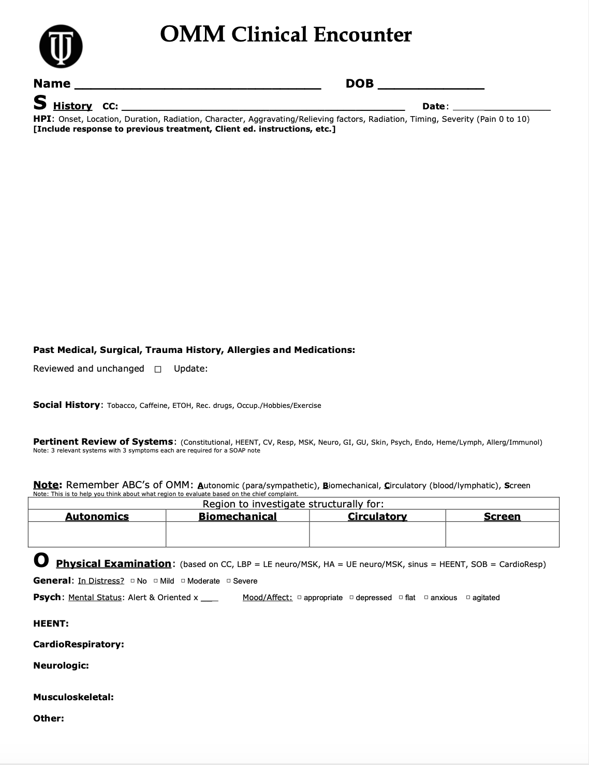
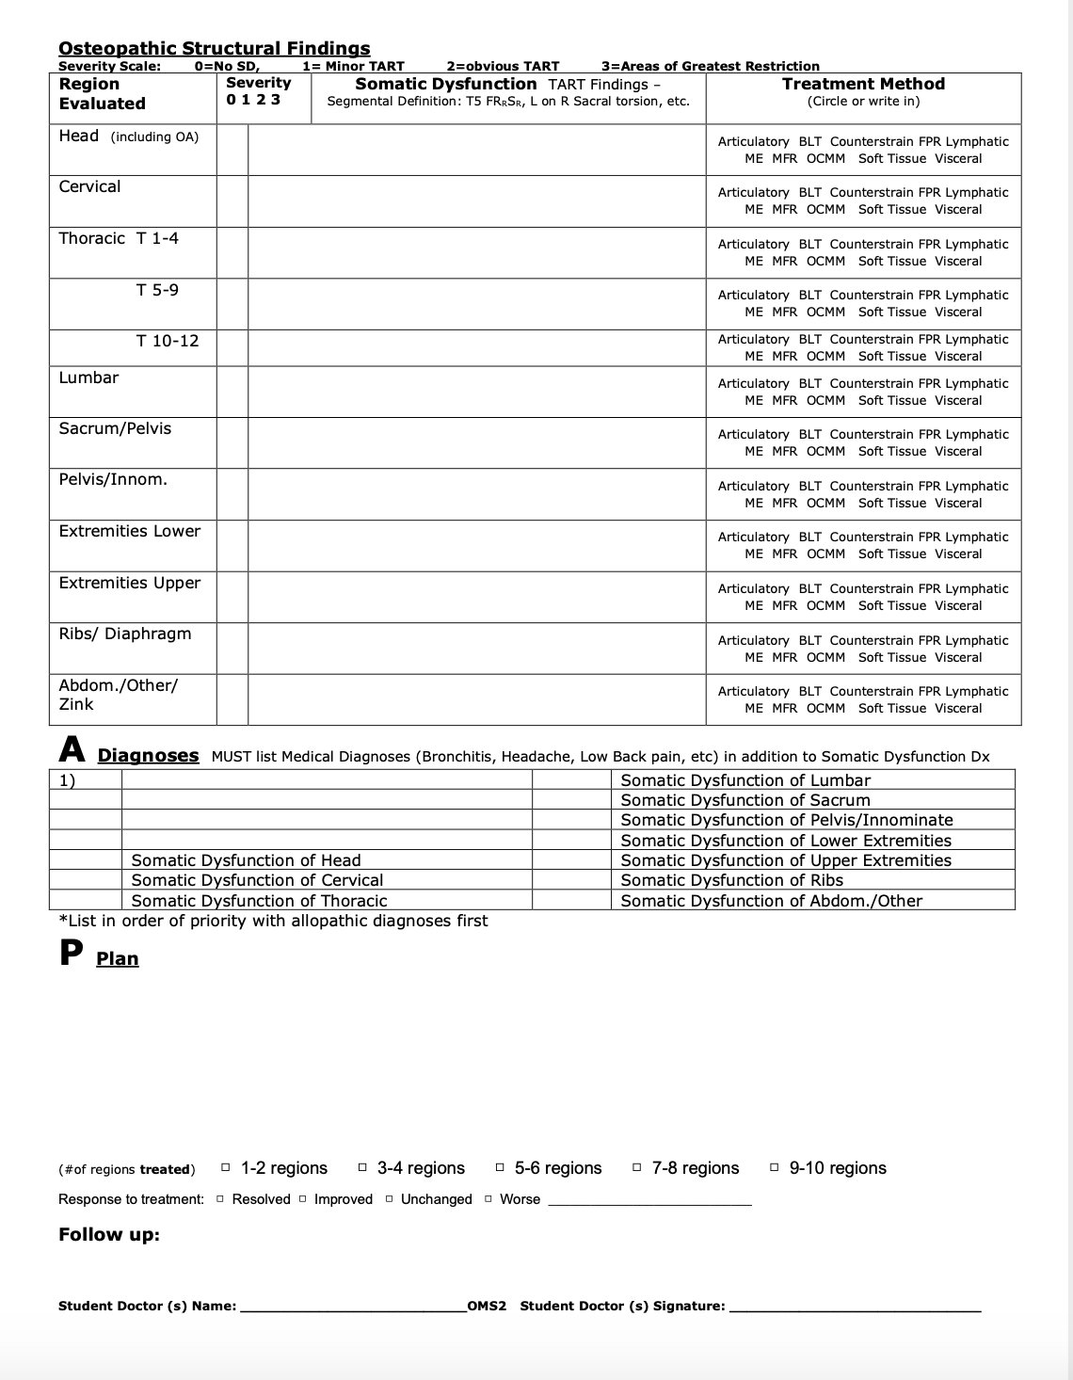
SOAP Note for Patient Encounter with OMT

Slide 35
Ways to get more OMM in your life
SAAO Lunch Time Clinic
Student Run Free Clinic
Touro OMM Facebook Page (@TUCCOMOMM)
3rd year elective
4th year rotation
TLC
Berkeley Suitcase Clinic

Slide 36
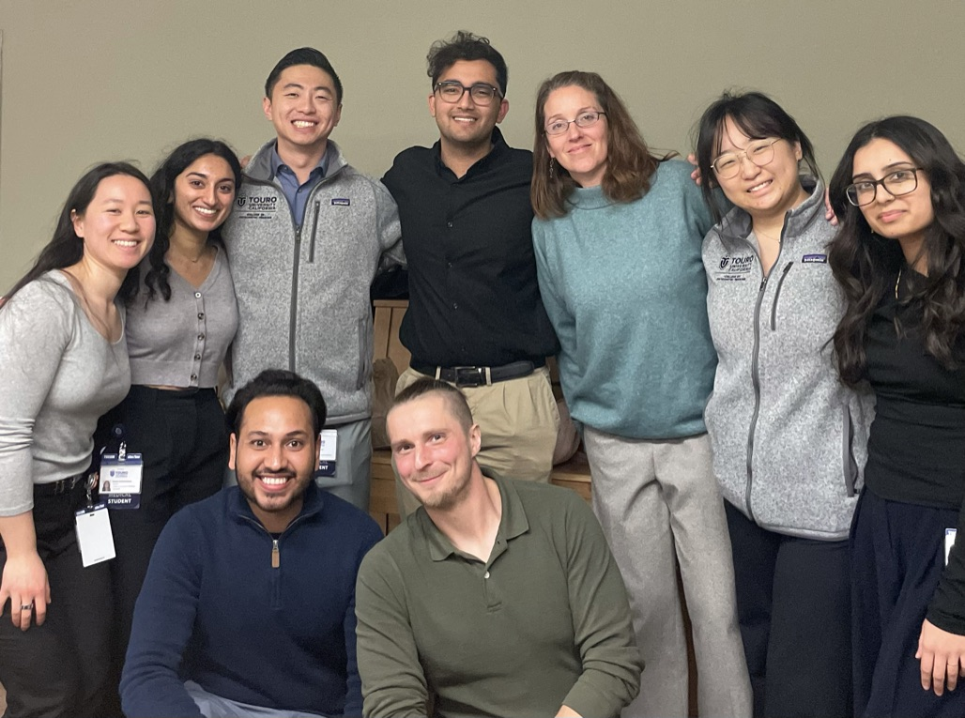
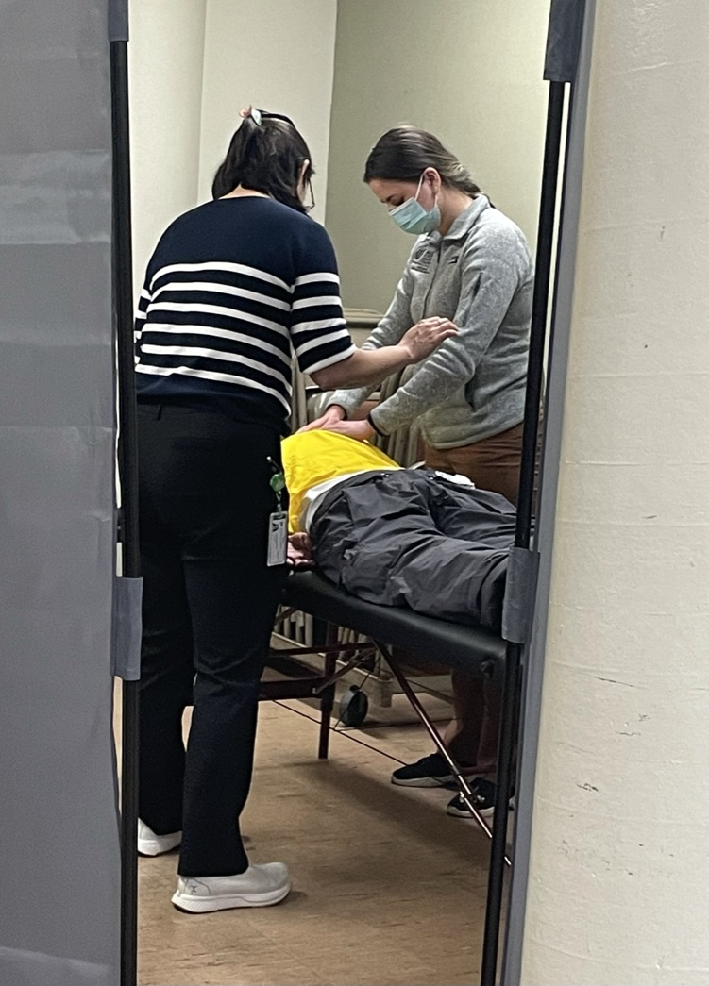

Berkeley Suitcase Clinic
Some Tuesday Evenings 6-9 in Berkeley
Bring OMT to the unhoused population
Work in pairs with your friends and classmates
Practice for the Comprehensive Exam
Help Dr. Sloane out

Slide 37
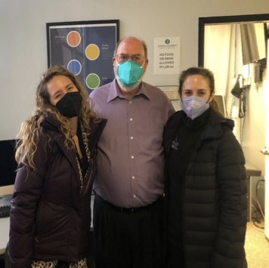
Teaching and learning center
Staffed by OMM Fellows and Touro students from all levels
Can be an option for ECE
Students and Fellows are able to practice under supervision:
History taking
Physical exam skills
Osteopathic Structural Exam
Developing a differential diagnosis
Designing a plan incorporating OMM
Schedule online here: https://ommdepartment.timetap.com/

Slide 38
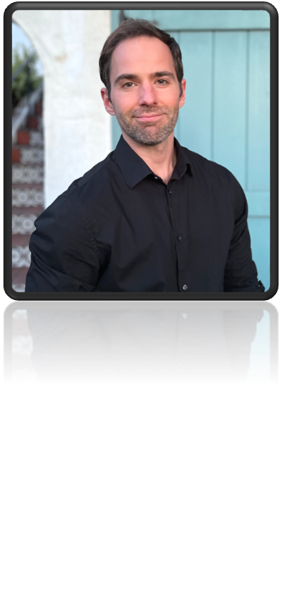
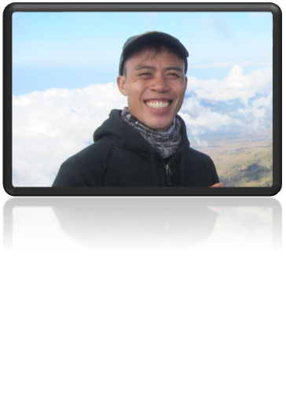
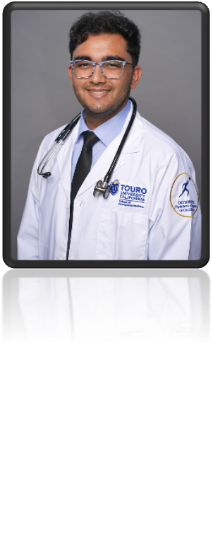
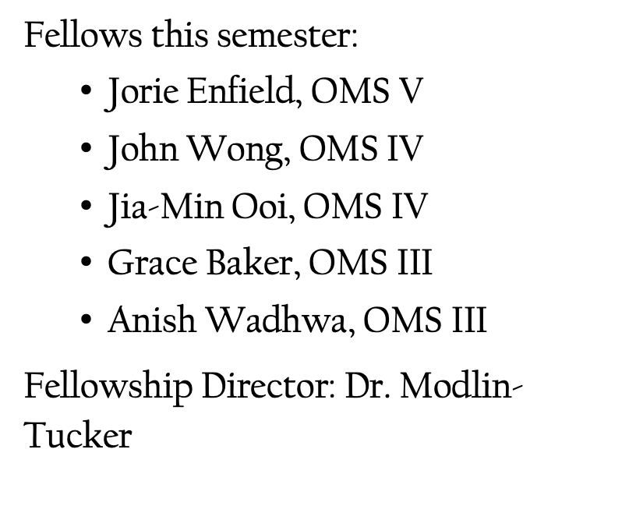
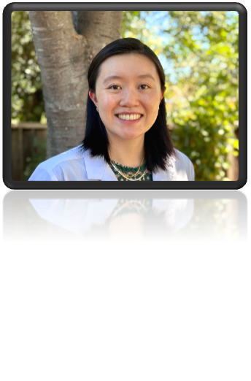
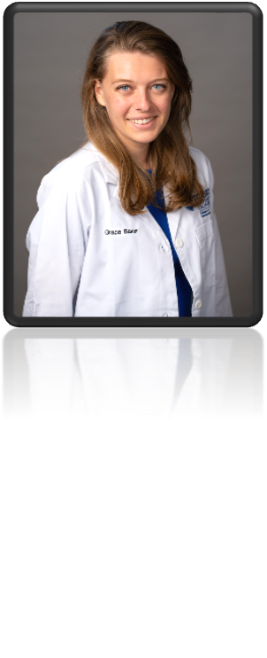
FeLLOWS!!!!

Slide 39
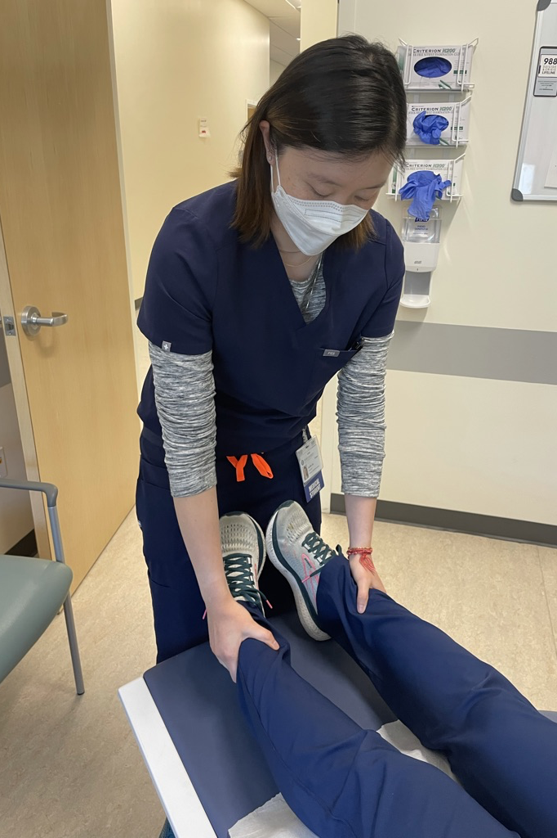
OMM Fellows
Become an OMM Fellow!
Fellowship Director: Dr. Modlin-Tucker
Apply, interview, and are selected in OMS II year – get ready!!
Complete five years at Touro COM
The extra time is divided over 3 years (few months each in OMS III-V years)
Pay 1/3 tuition for years 3, 4 and 5
Annual stipend in OMS III-V
Health insurance covered while a Fellow
Priority in clinical rotation selection
AAO Convocation covered each year

Slide 40
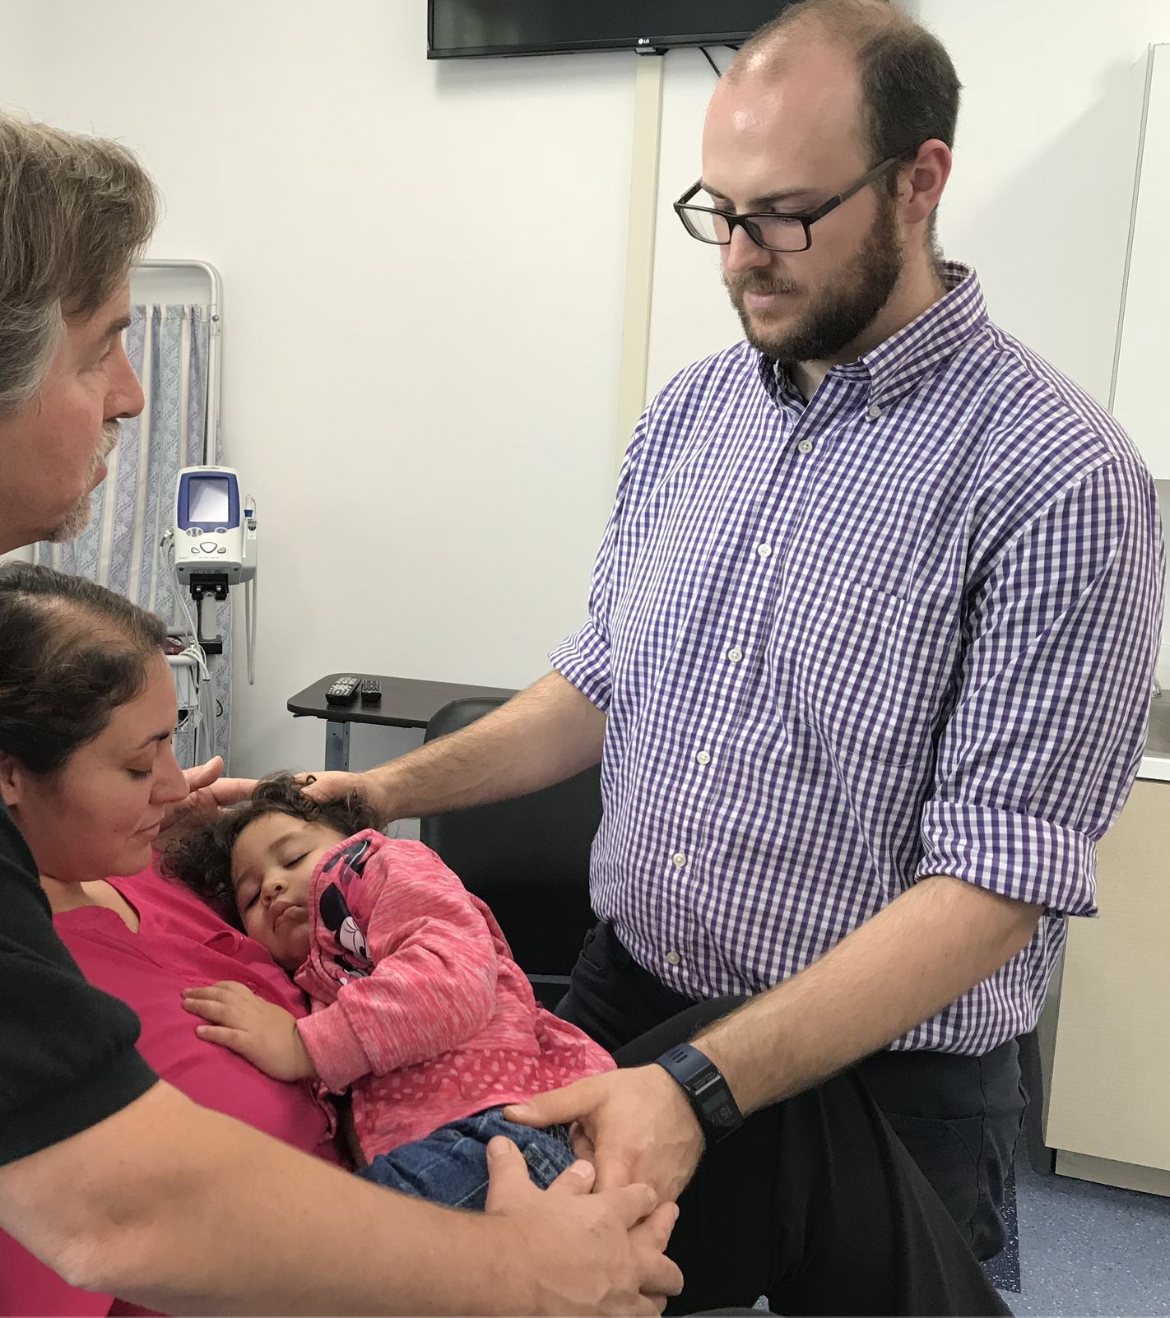
Perks of the OMM Fellowship
Mentorship and guidance from OMM department
Strengthens a CV when applying for residency and jobs
Freedom to design your own project–research or other
Most of our Fellows published in some venue
Extra time to develop your OMM skills
OMT Lab at TLC
Lab with OMS I and IIs
Out rotations with private practice physicians
American Academy of Osteopathy’s Convocation
Opportunity to become a stronger teacher
Function as a junior faculty member and deliver lectures and labs
And so much more!

Slide 41
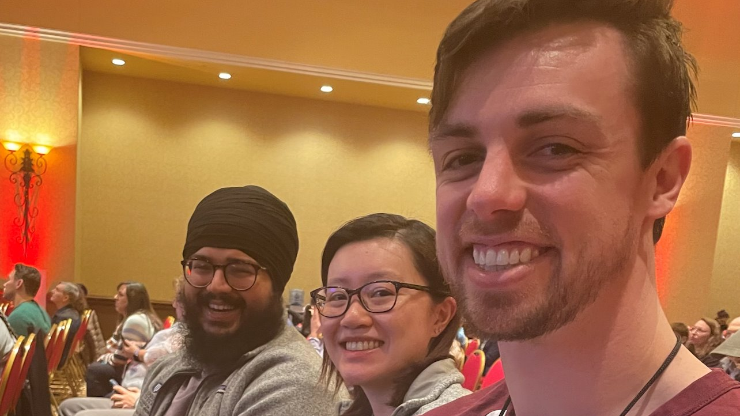
Application
Will begin the application process this fall –stay tuned for details!
Any questions – contact Dr. Modlin-Tucker
To apply:
One page letter of intent
Transcripts
Curriculum Vitae

Slide 42
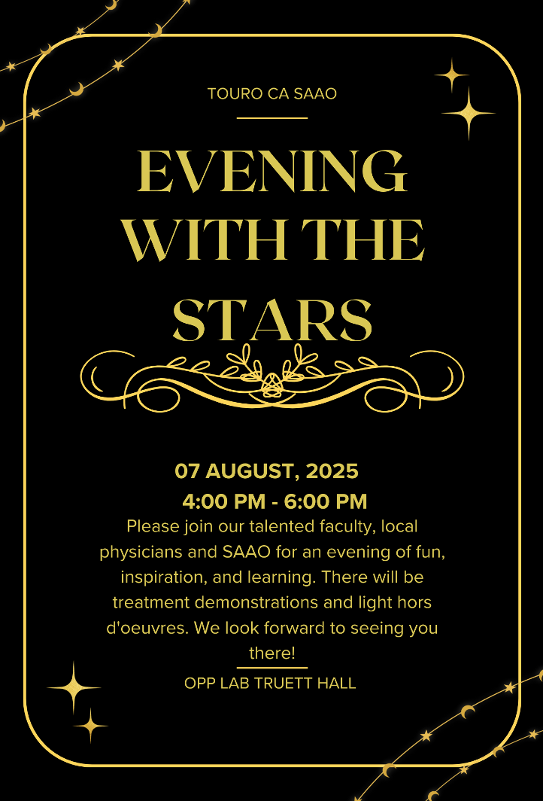
Questions?!?!

